Slide 1

Social Media Application
Members:
Shivam Gupta
Aditi Tandel
Jay Awale
Karthikeyan
Tanusha
Varun Bhatia

Slide 2
Problem Statement
The role of social media becomes more and more important, than ever before. From a person's daily life routine, to weather information and even emergency and other essential services can be accessed on social media.
Through this application, users should be able to connect to people, send a friend request, accept a friend request sent, post comments, share and view status, access an emergency service.
Create groups and forums over specific topics and allow users to join those groups and forums and post comments .
The system should allow for likes, dislikes, comments. Also allow a user to unfriend or block other users from his group, page or friend list.

Slide 3
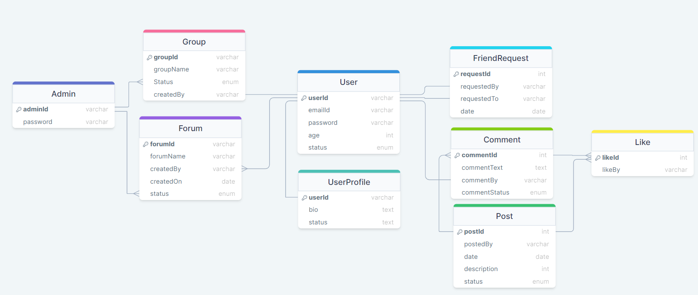
Database Diagram

Slide 4
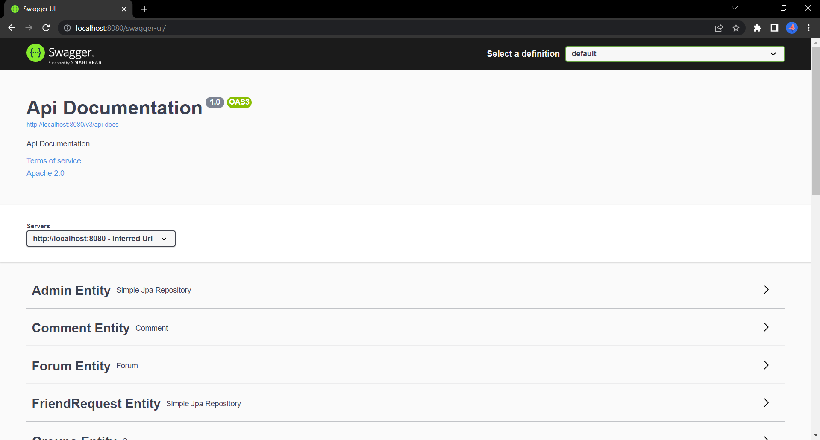
Sprint-1: Testing the APIs using Swagger

Slide 5
Sprint-2:
Deployment on Cloud
Social media applications should meet the requirement of High availability.
All the application dependencies should be packed as a Docker Image along with the application. So when we run the Docker Image, the Application should run seamlessly without any dependency issues.
The application should be available all the time by deploying in Kubernetes using K8’s deployments. The application should use a load balancer and auto-scaling in AWS, and also utilize the resources and scale up immediately with a ‘pay for usage’ policy using AWS EKS.

Slide 6
Using Docker
Install docker
apt-get install docker
Clone the github repository
git clone repository_name
Create a Dockerfile
vi Dockerfile.yml
Build an image
docker build . -t image_name
Create a docker-compose file
vi docker-compose.yml
Run the docker compose
docker compose up

Slide 7
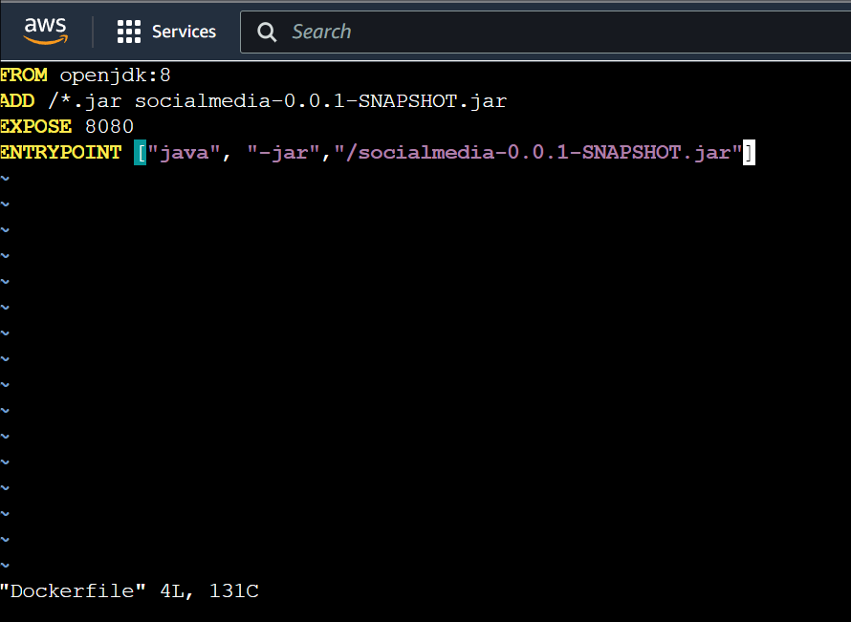
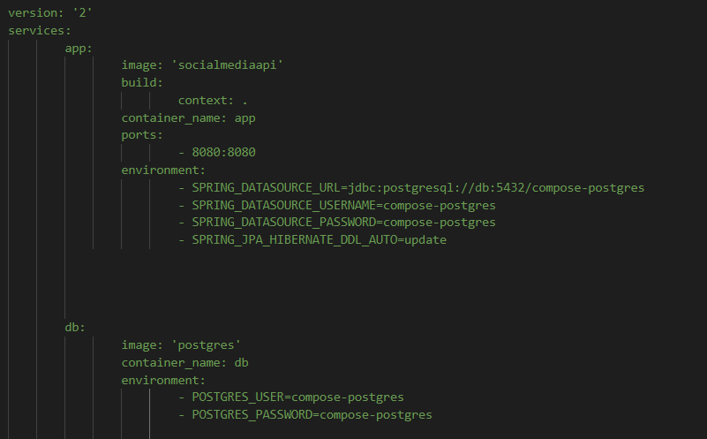
Dockerfile and docker-compose file

Slide 8
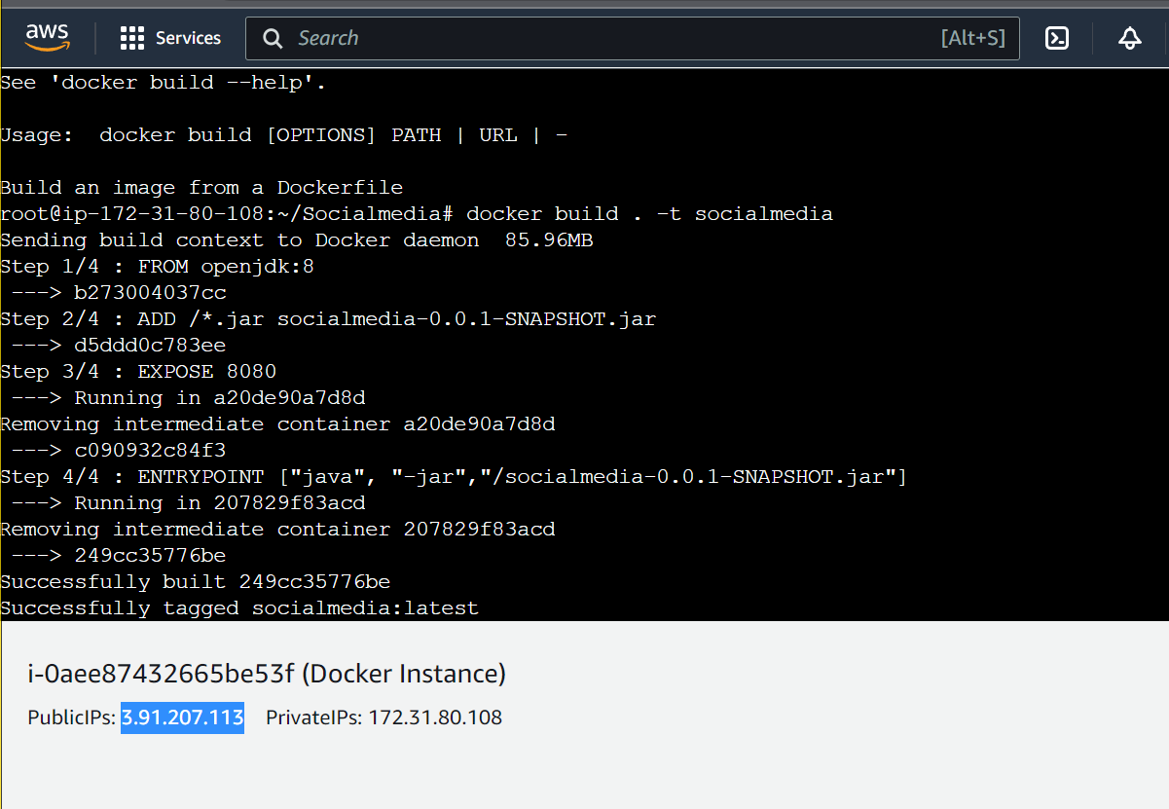
Building an image

Slide 9
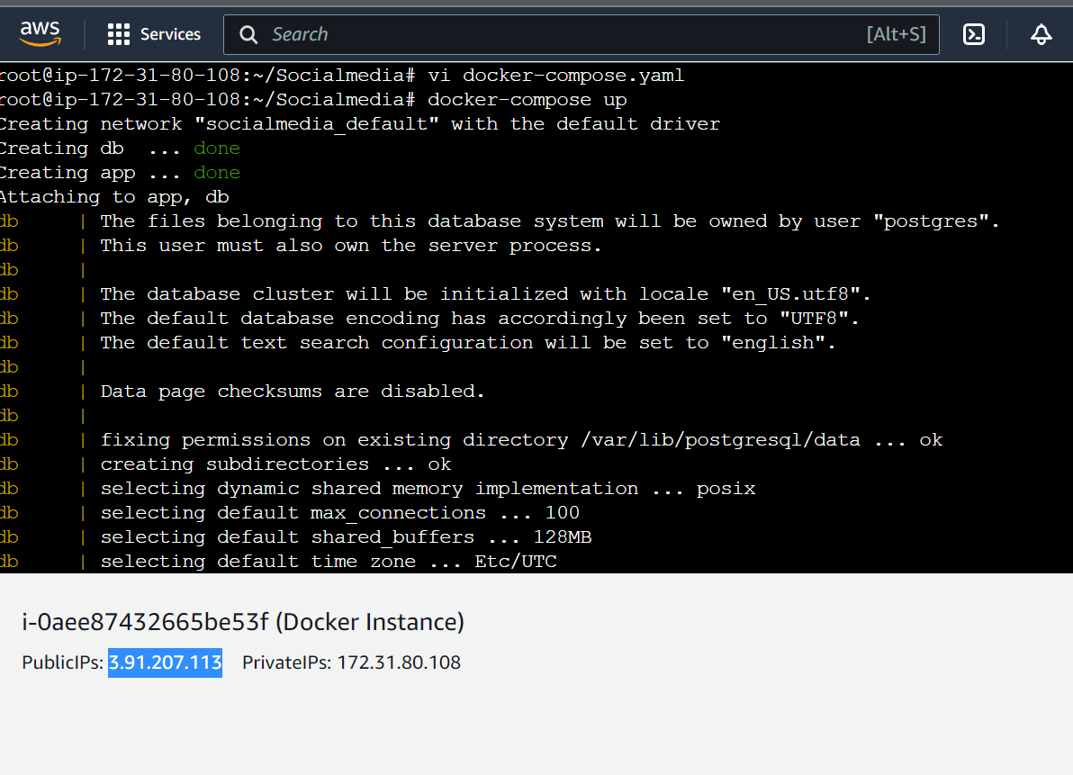
Running the docker-compose

Slide 10
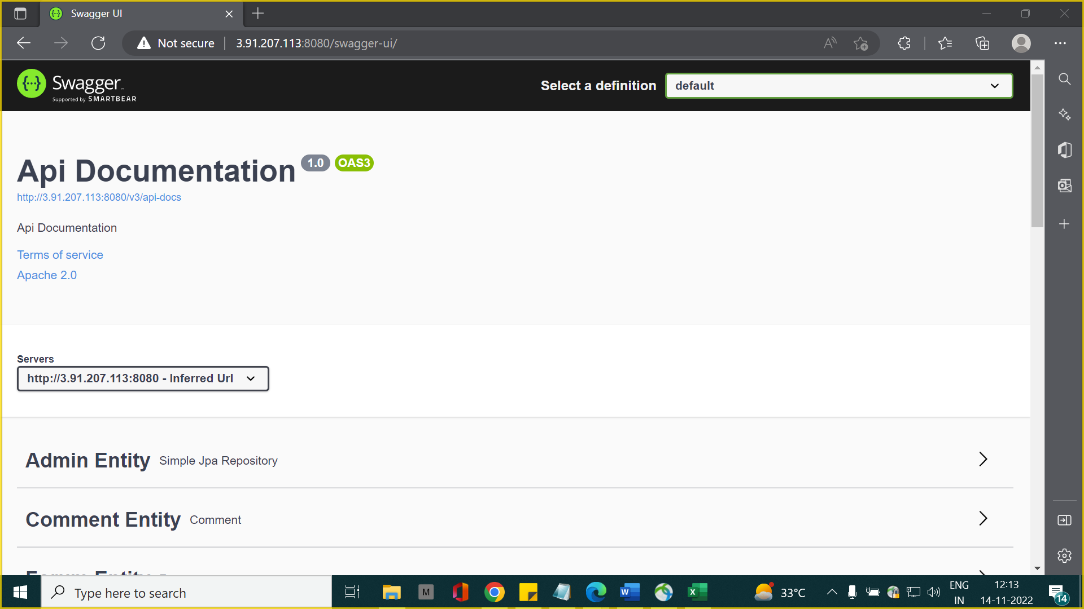
Deployment on web browser
from public IP

Slide 11
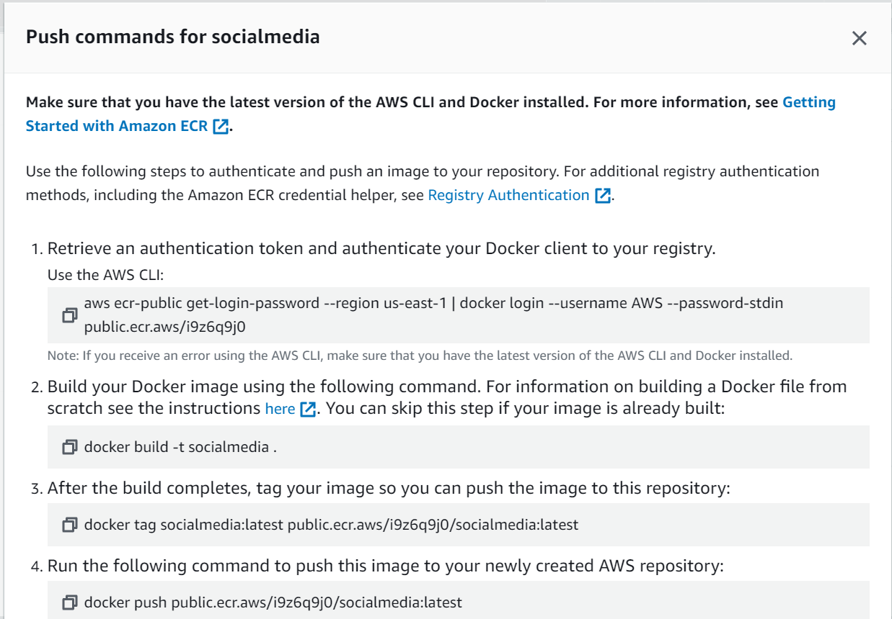
Add image to AWS Image Registry

Slide 12
Using Kubernetes- EKS
Make an EKS cluster
Create a Deployment manifest file
Create Service Manifest files
Run the deployment file and Service files
Check all the running pods and services

Slide 13
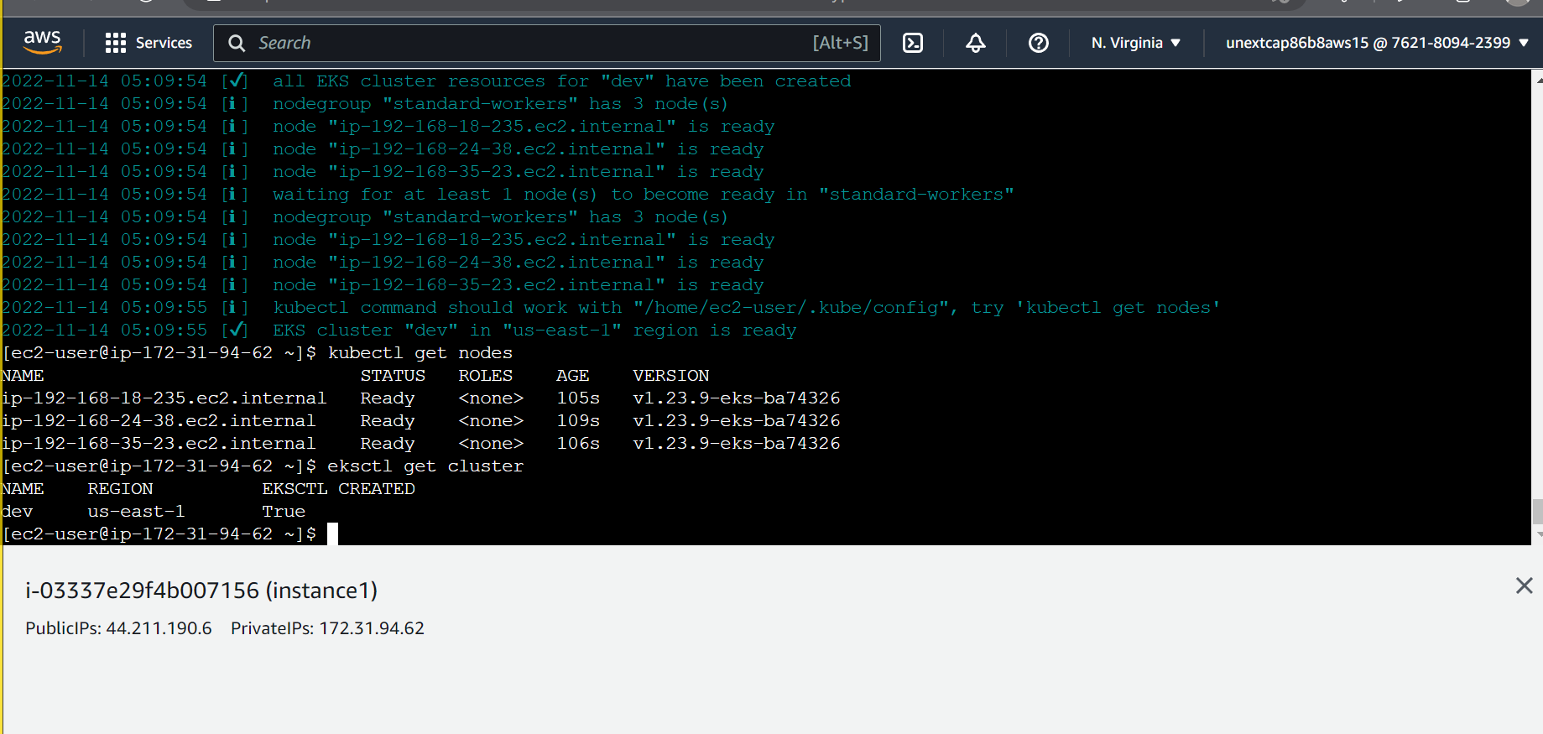
Make an EKS cluster

Slide 14
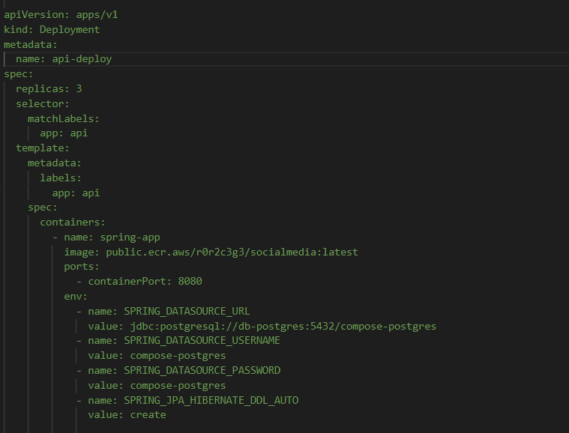
2. Create a Deployment manifest file

Slide 15
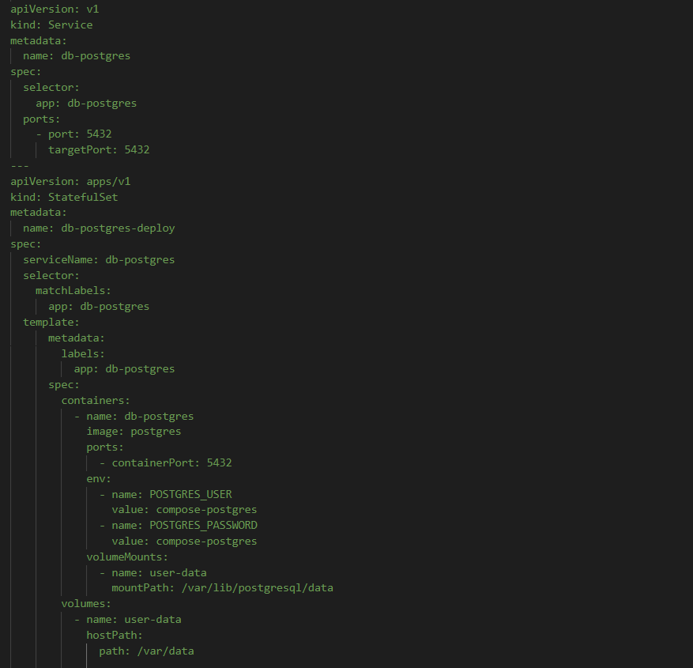
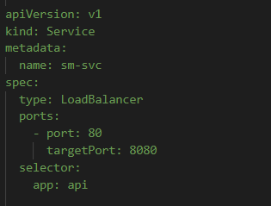
3. Create Service manifest file

Slide 16
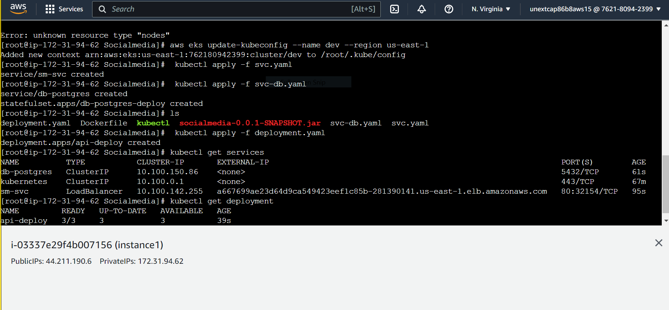
4. Run the deployment file and Service files

Slide 17
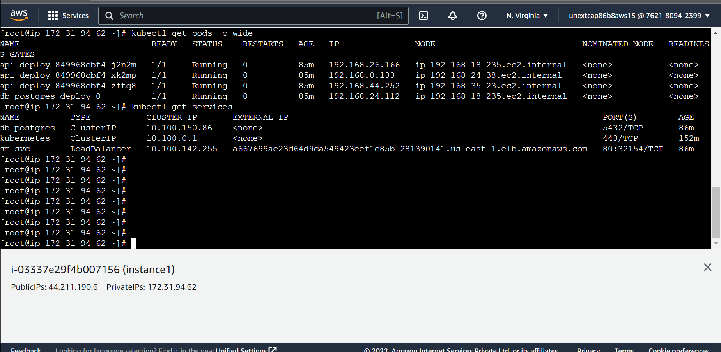
5. Check all the running pods and services
External IP

Slide 18
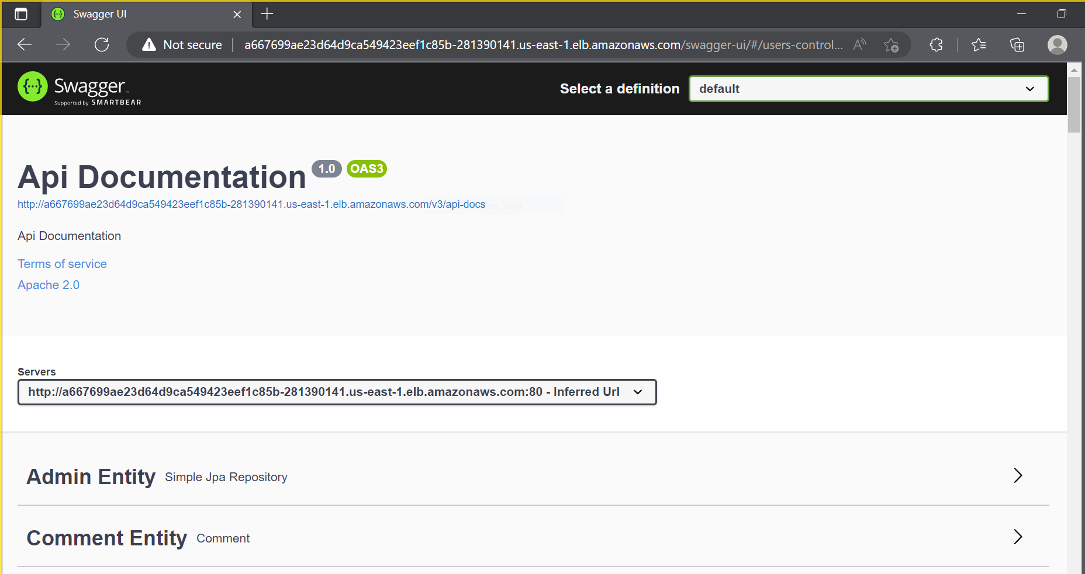
Deployment on web browser
From External IP

Slide 19
Thank You!

